Slide 1

Welcome to the Naruse Zoo

Slide 2
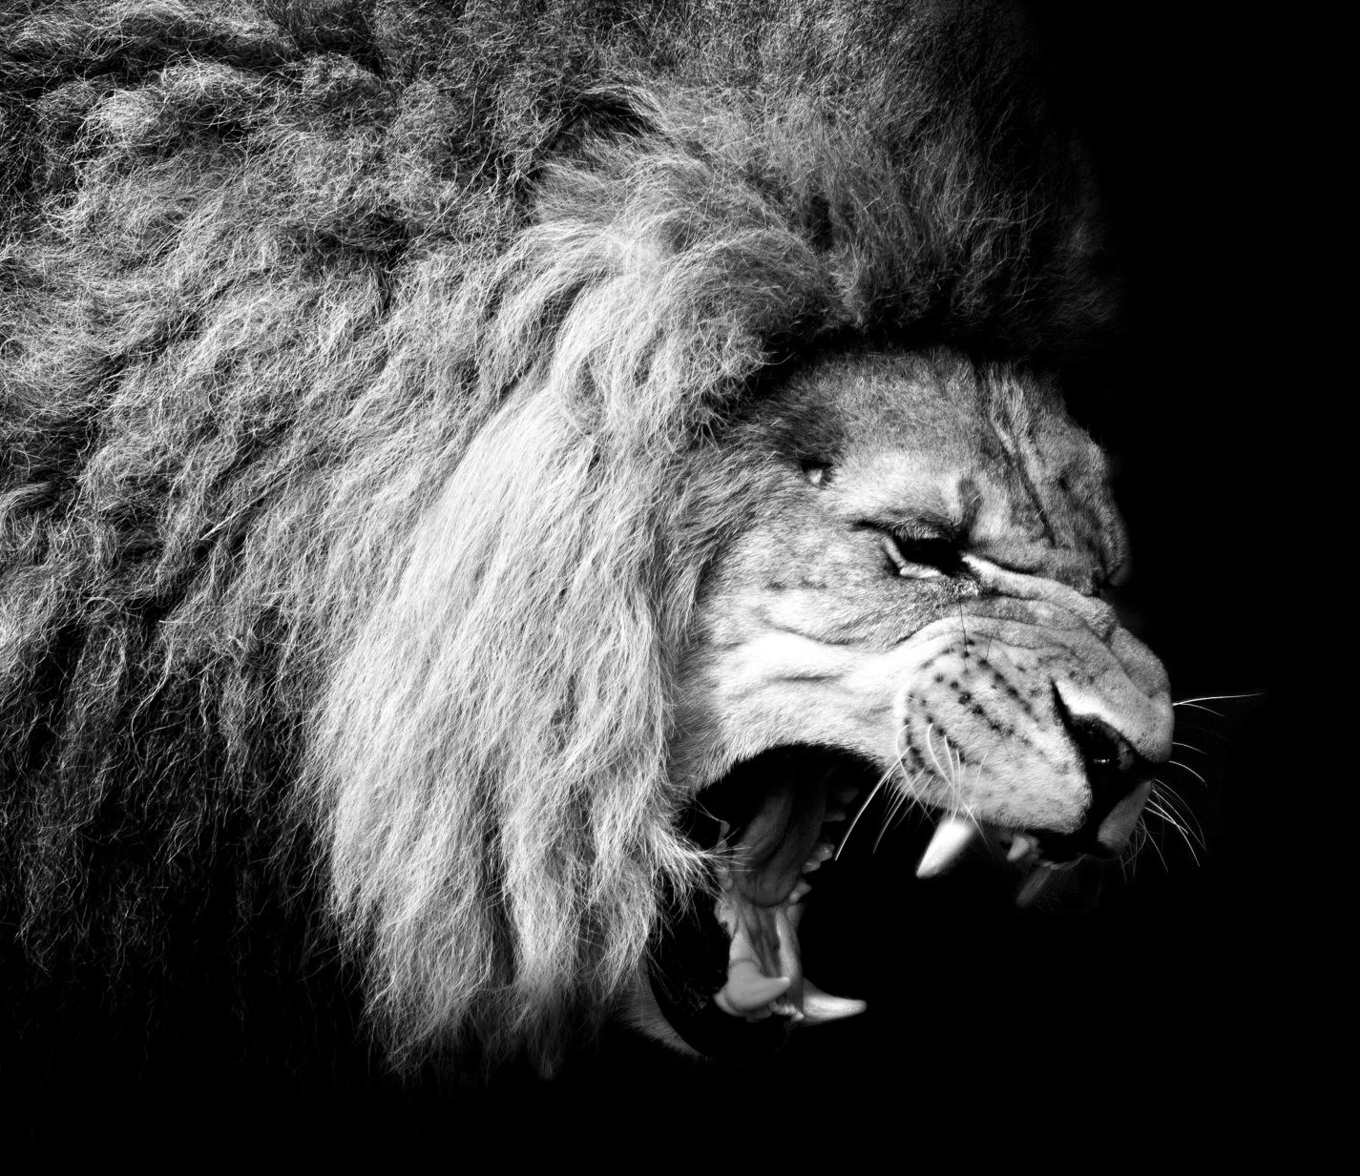
Lion
The lion usually sleeps for 15 hours to 20 hours.

Slide 3
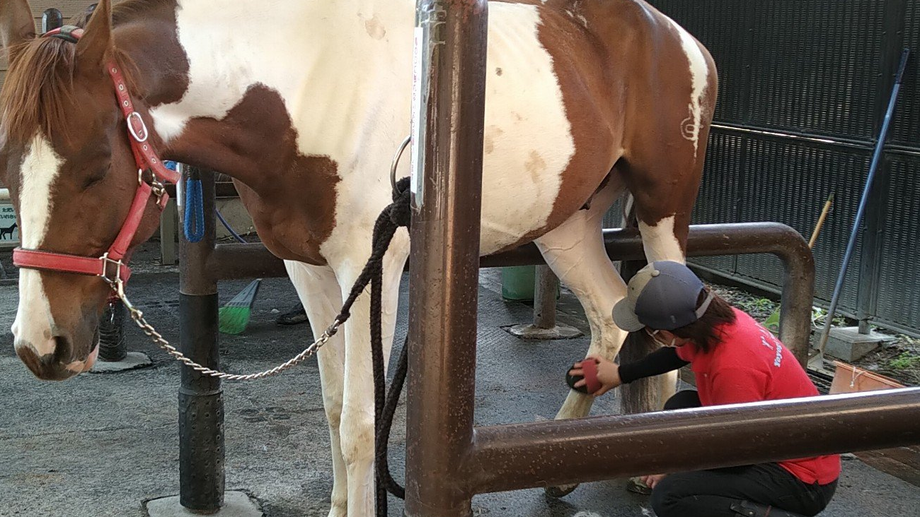
Horse
The horse can sleep standing up.

Slide 4
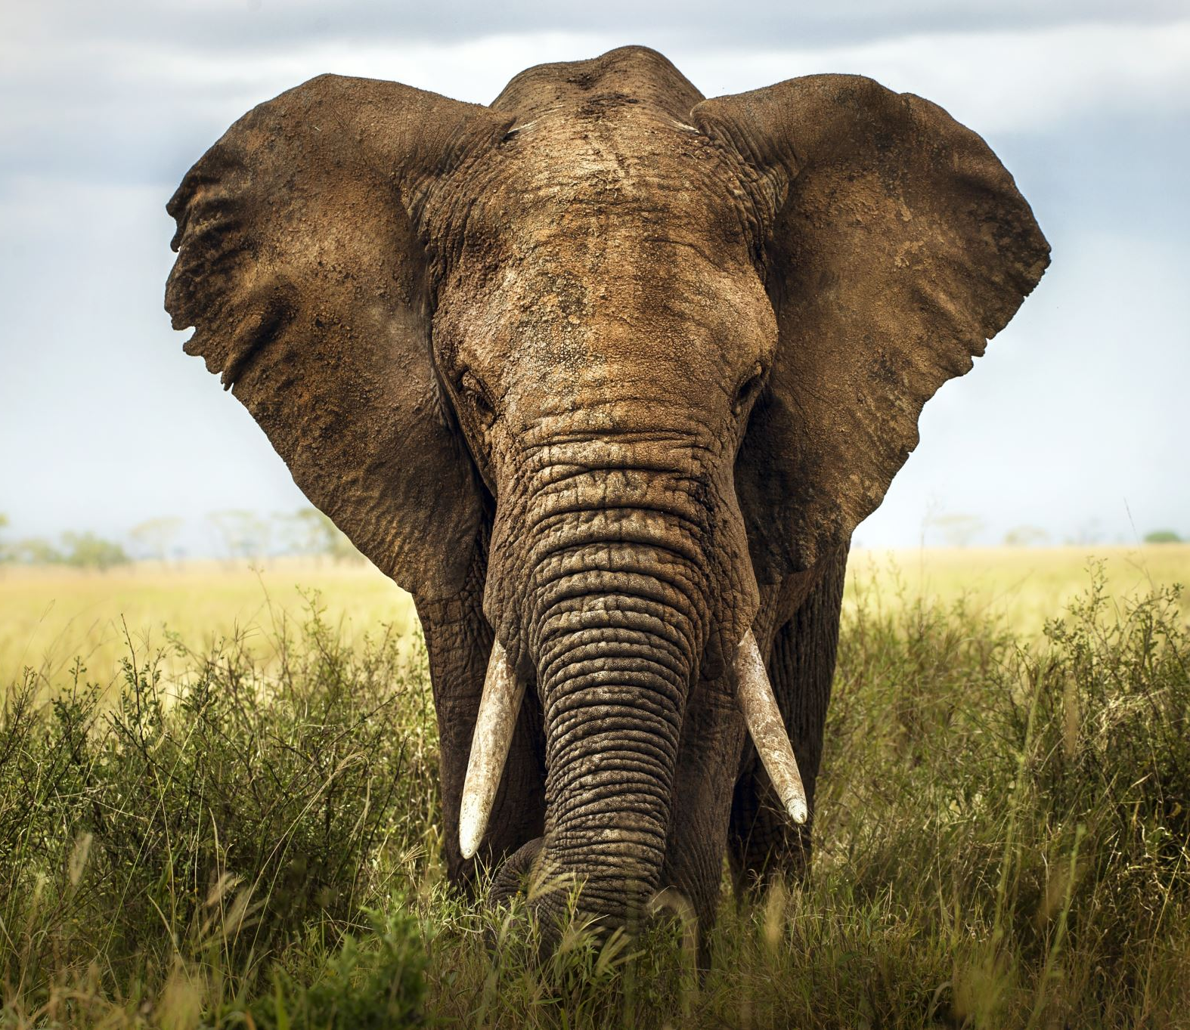
Elephant
The elephant can not jump.

Slide 5
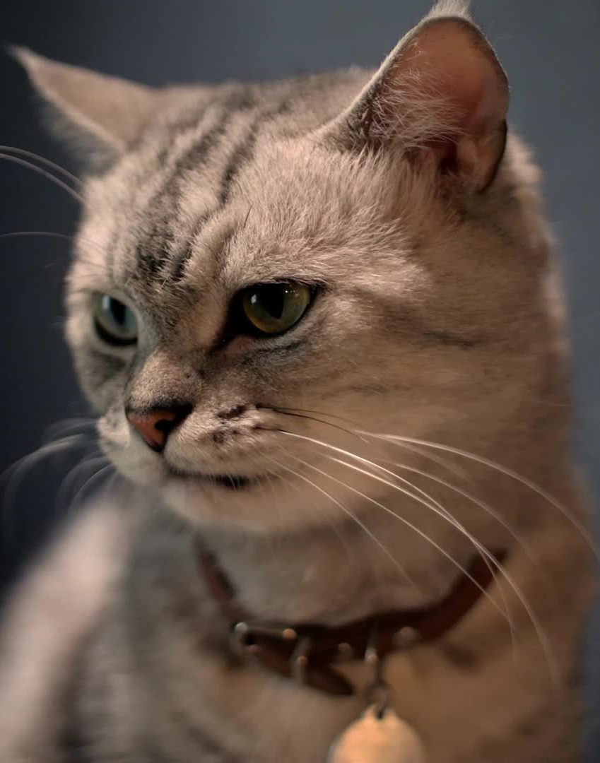
Cat
Cats can know the weather by their whiskers.

Slide 6
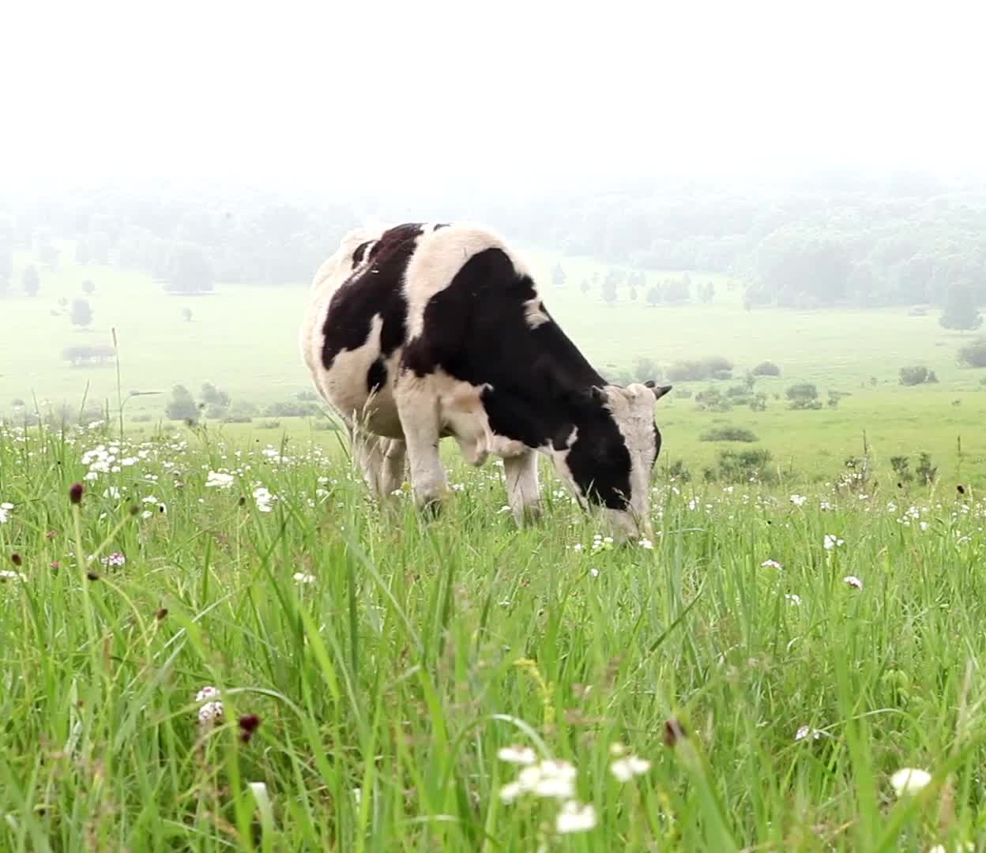
Cow
The cow has four stomachs.

Slide 7
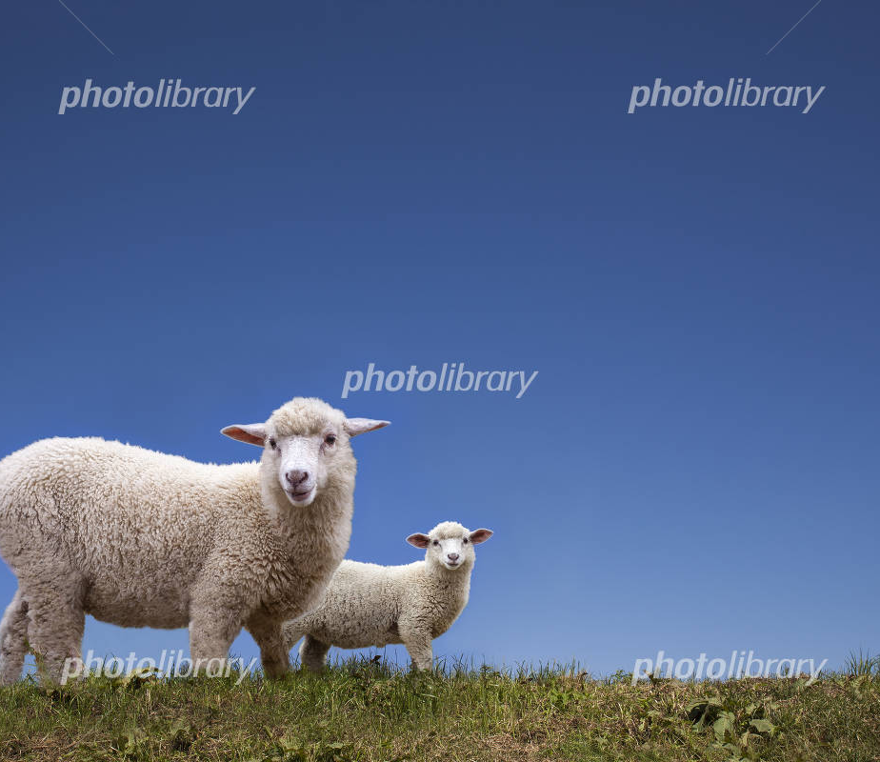
Sheep
Sheep like to be with their friends.

Slide 8
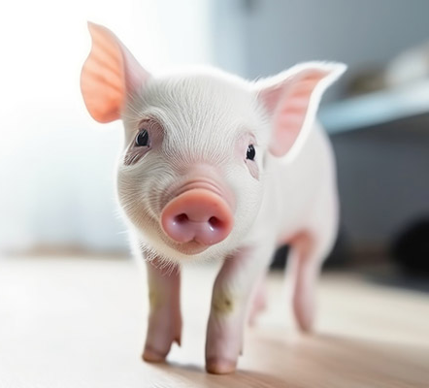
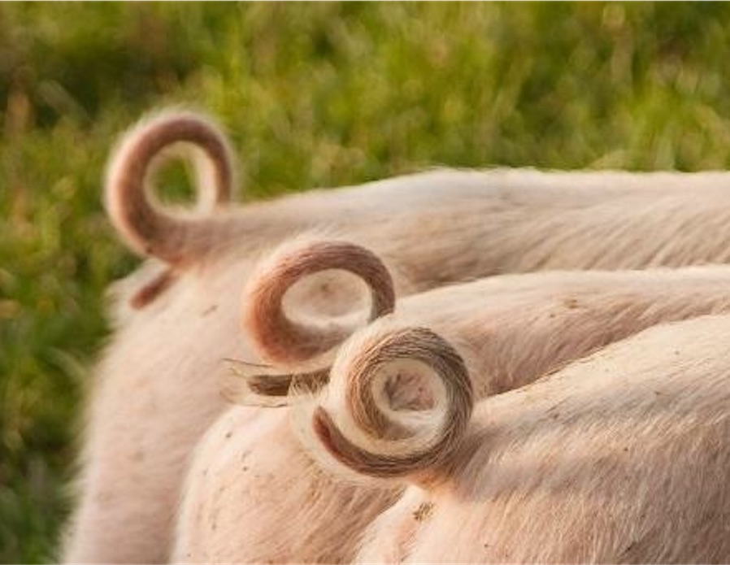
Pig
The pig's tail is curly.

Slide 9
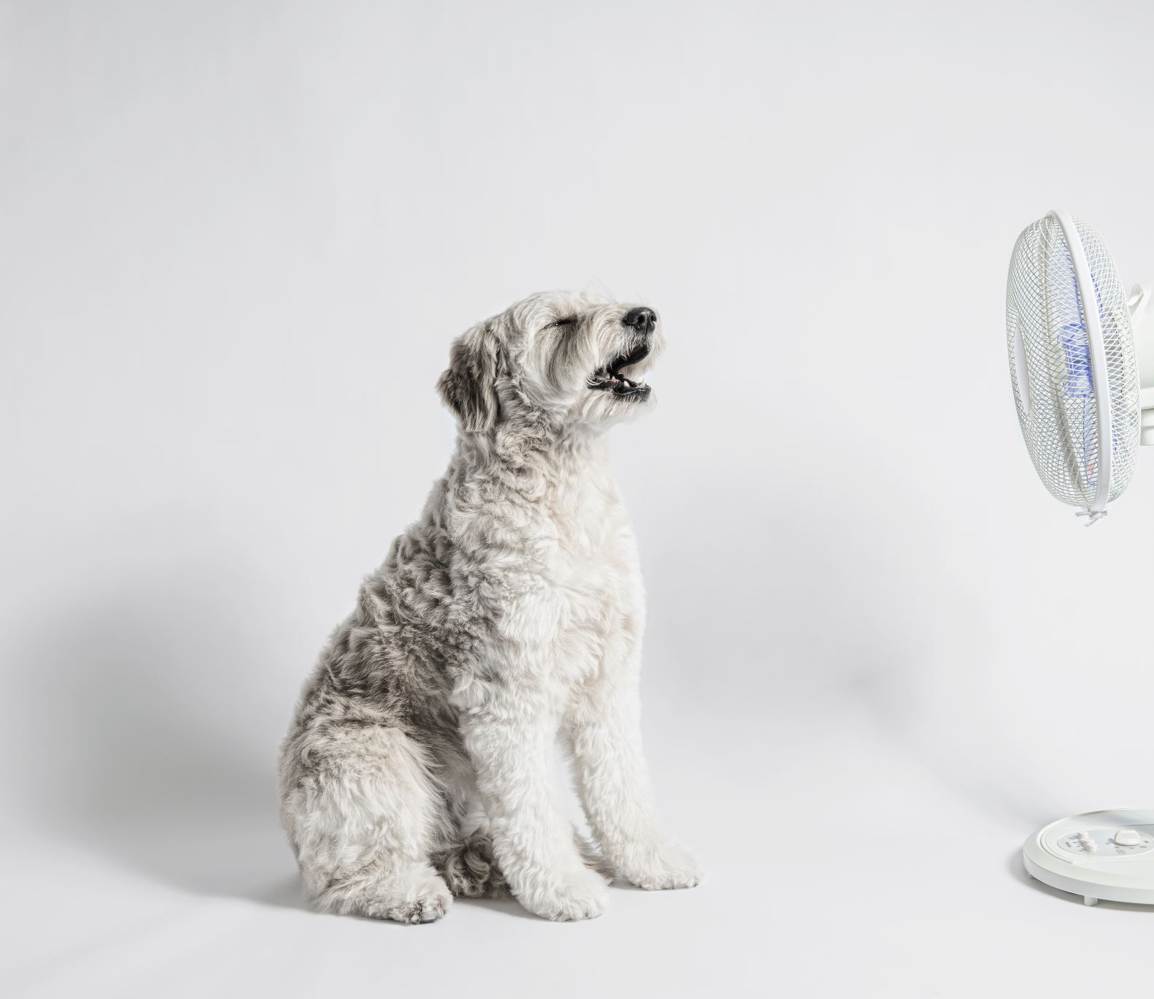
Dog
The dog has an excellent sense of smell.

Slide 10
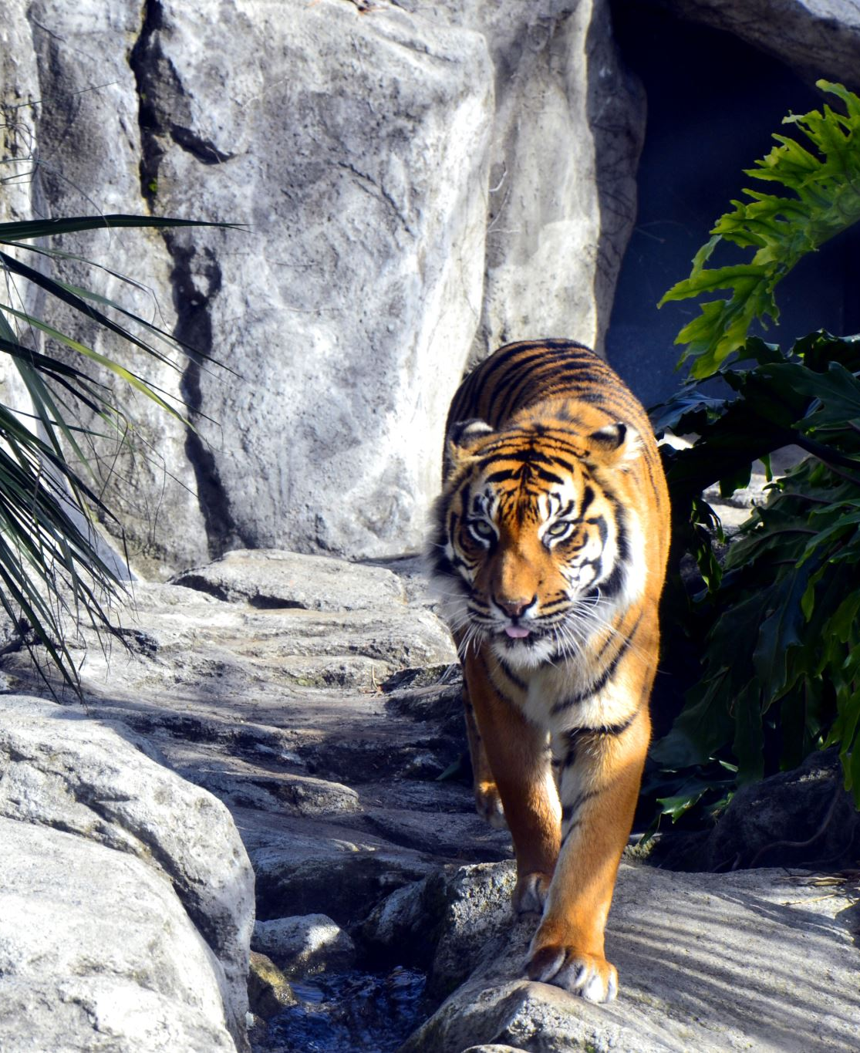
Tiger
The tiger’s body has stripes.

Slide 11
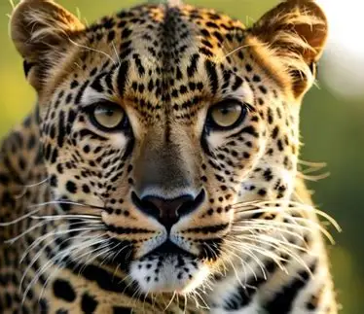
Leopard
The leopard has sharp claws.

Slide 12
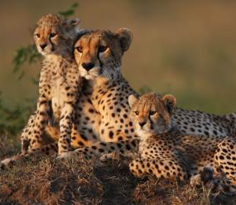
Cheetah
Cheetahs have teardrop-like patterns on their faces.

Slide 13
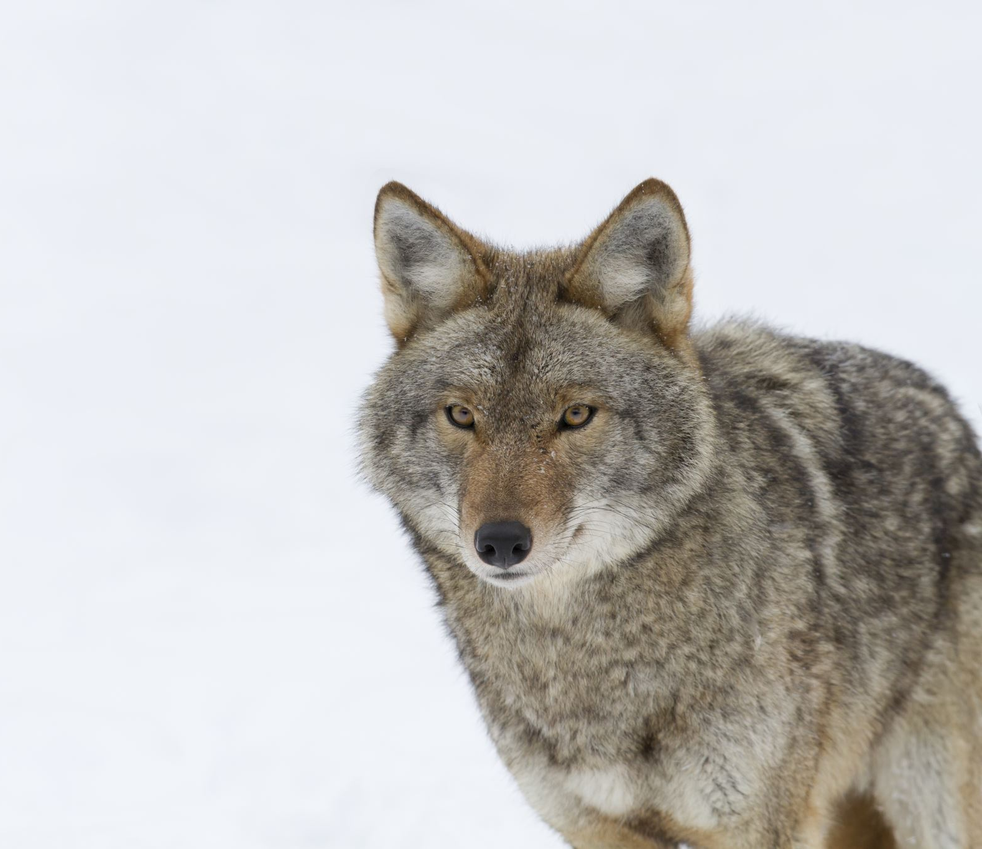
Wolf
The wolf lives in a group.

Slide 14
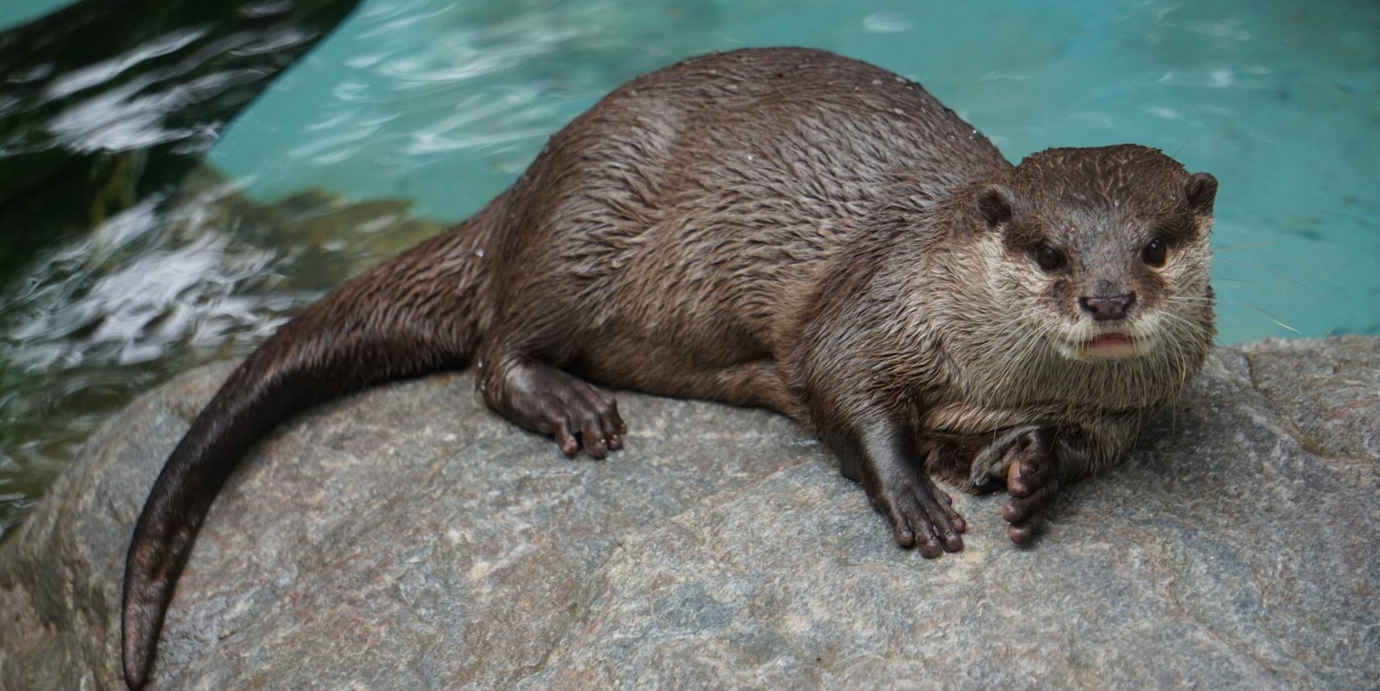
Otter
The otter's body is as long as the tail.

Slide 15
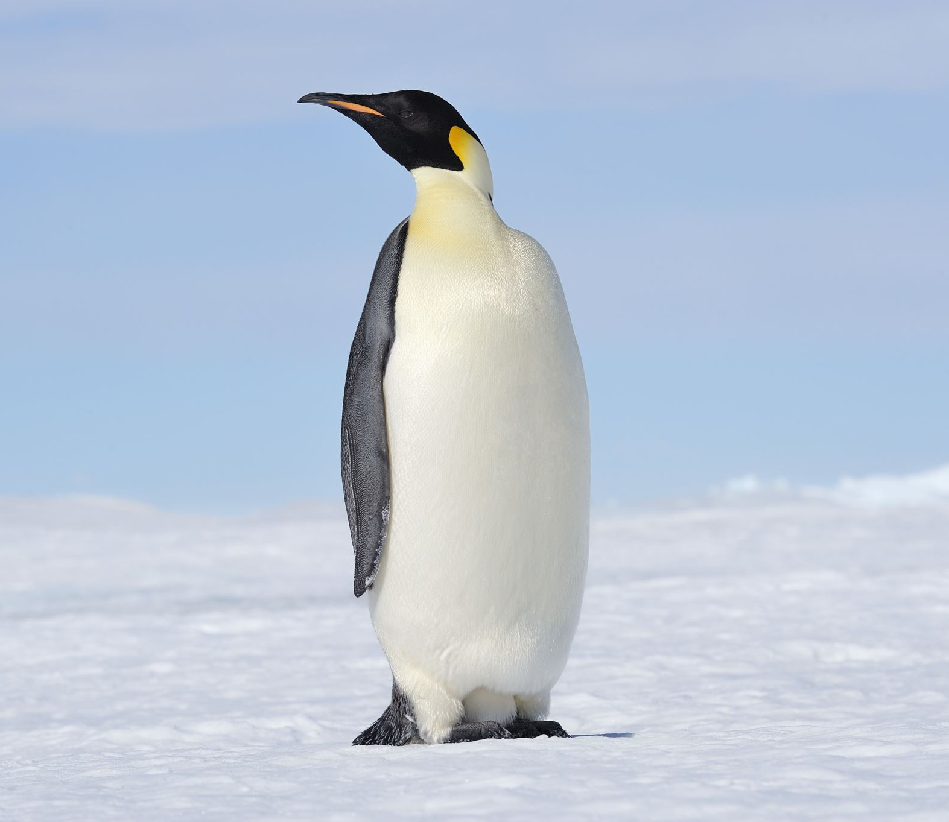
Penguin
The penguin can’t fly.

Slide 16
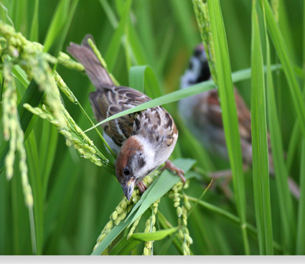
Sparrow
The sparrow's favorite food is rice.

Slide 17
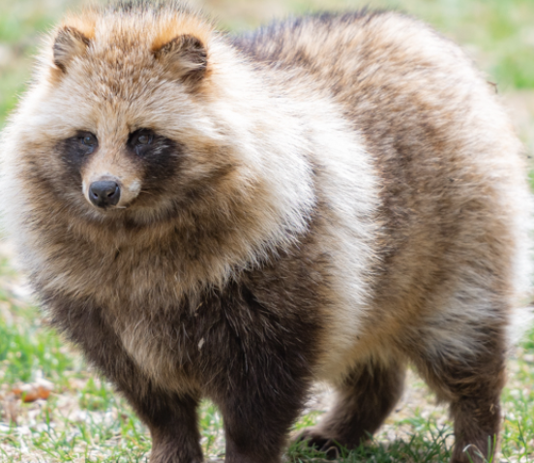
Raccoon dog The raccoon dog was rare a long time ago

Slide 18
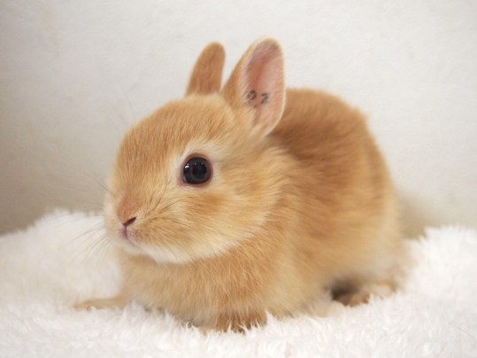
Rabbit
The rabbit is very cautious and timid.

Slide 19
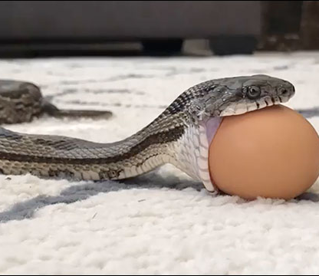
Snake
The snake can swallow eggs whole.

Slide 20
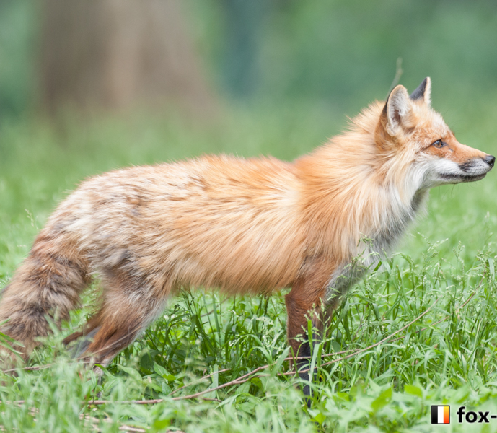
Fox
The fox has a slender body and a pointed nose.

Slide 21
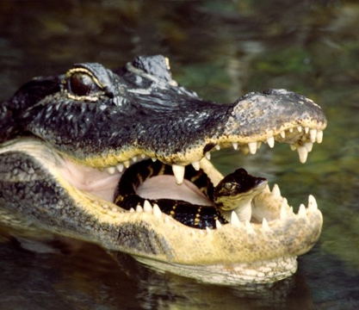
Crocodile/ Alligater
The crocodile carries their babies in the mouth.

Slide 22
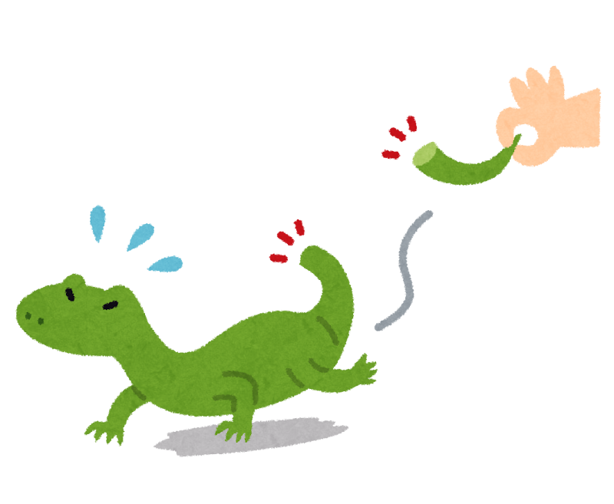
Lizard
The Lizard can detach its tail.

Slide 23
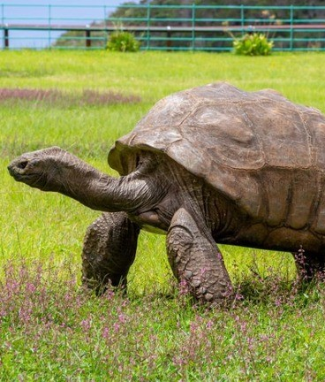
Tortoise
This tortoise is the oldest in the world.

Slide 24
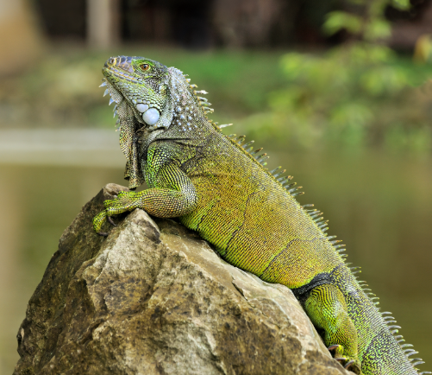
Iguana
The Iguana has a strong tail and sharp claws.

Slide 25
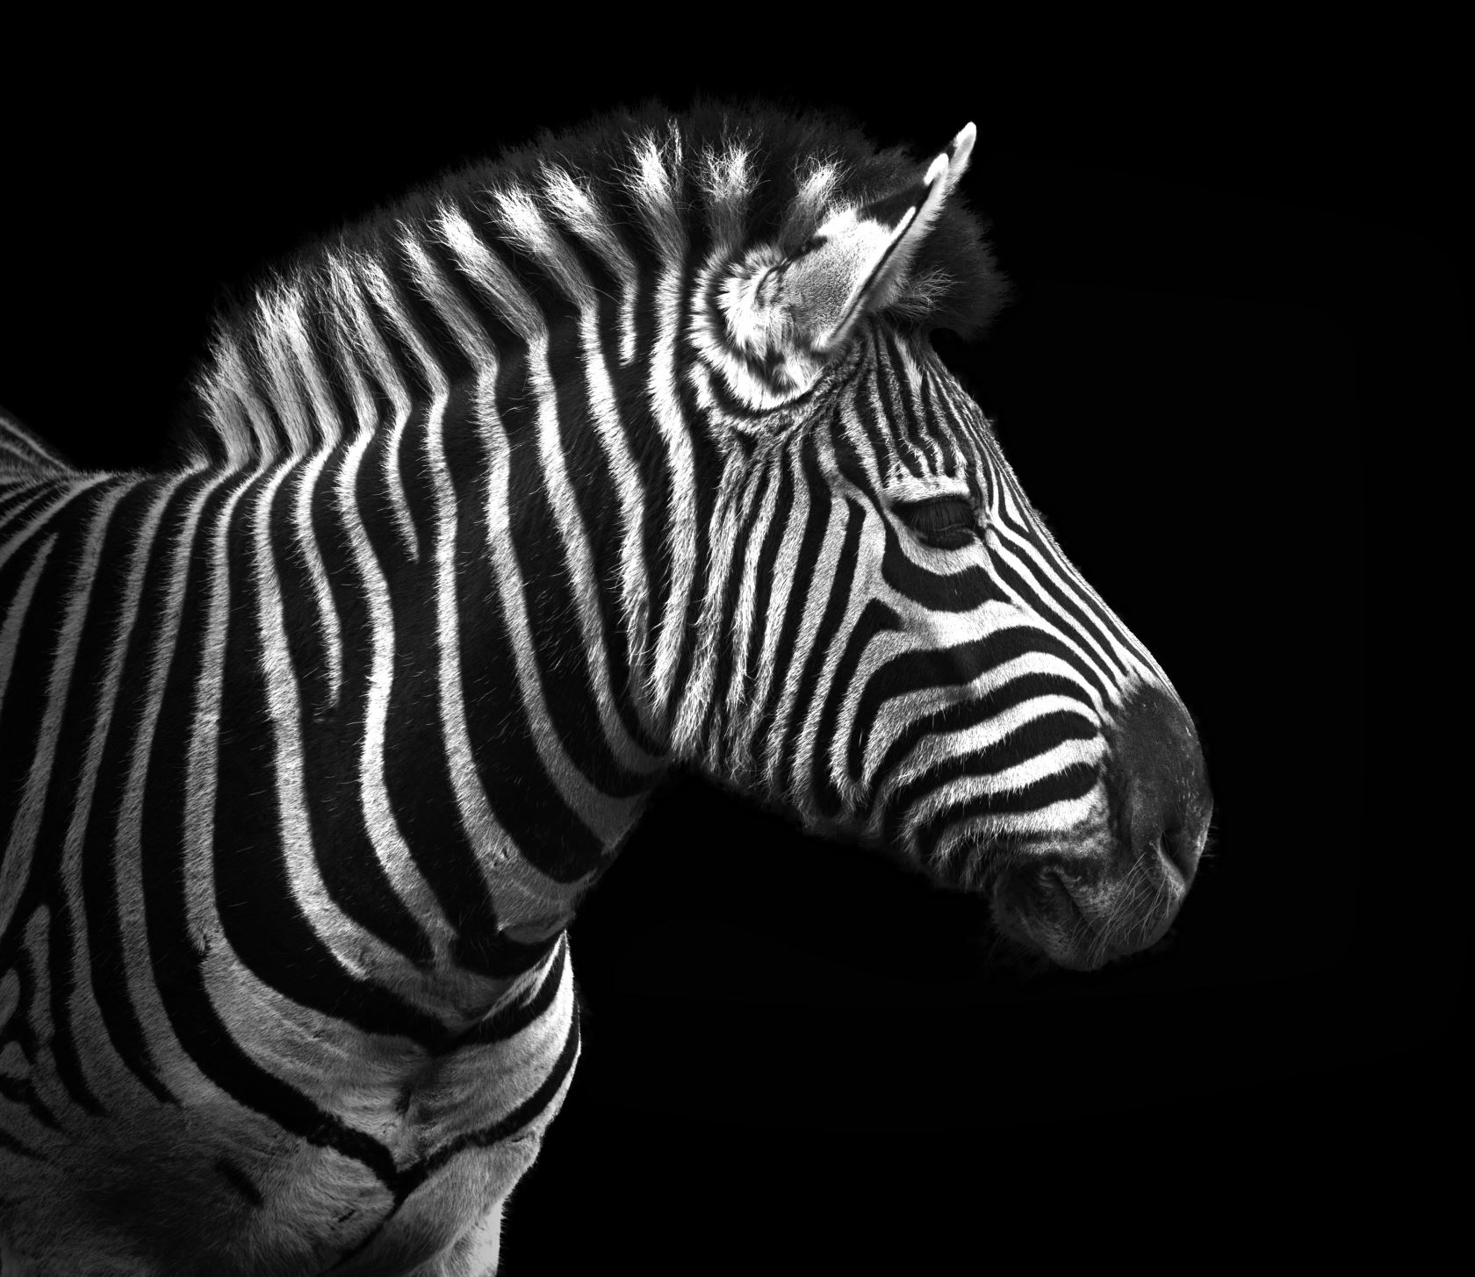
Zebra
The zebra is black and white

Slide 26
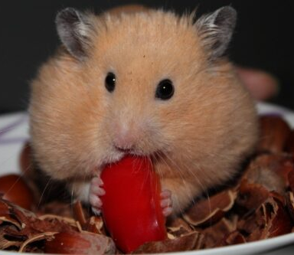
Hamster
This hamster has big cheeks.

Slide 27


Slide 28
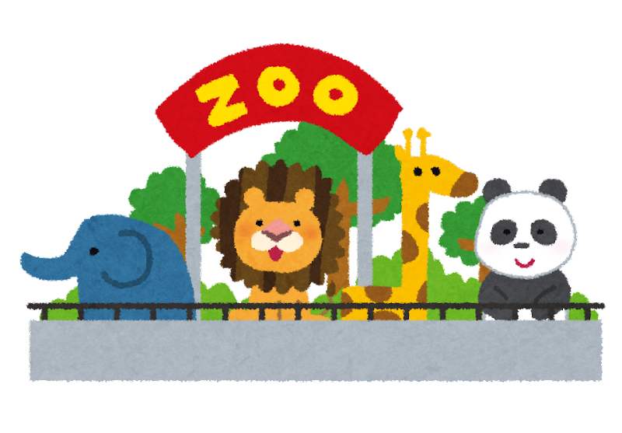

Slide 29
Animal Quizzes

Slide 30

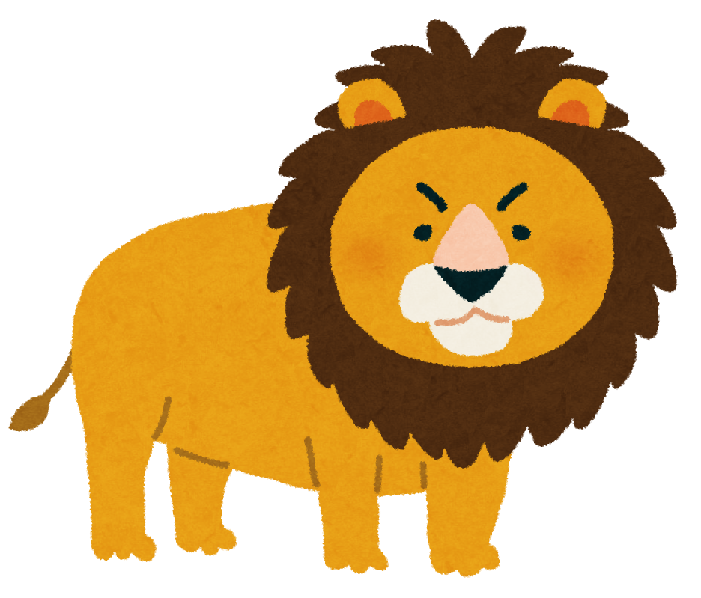
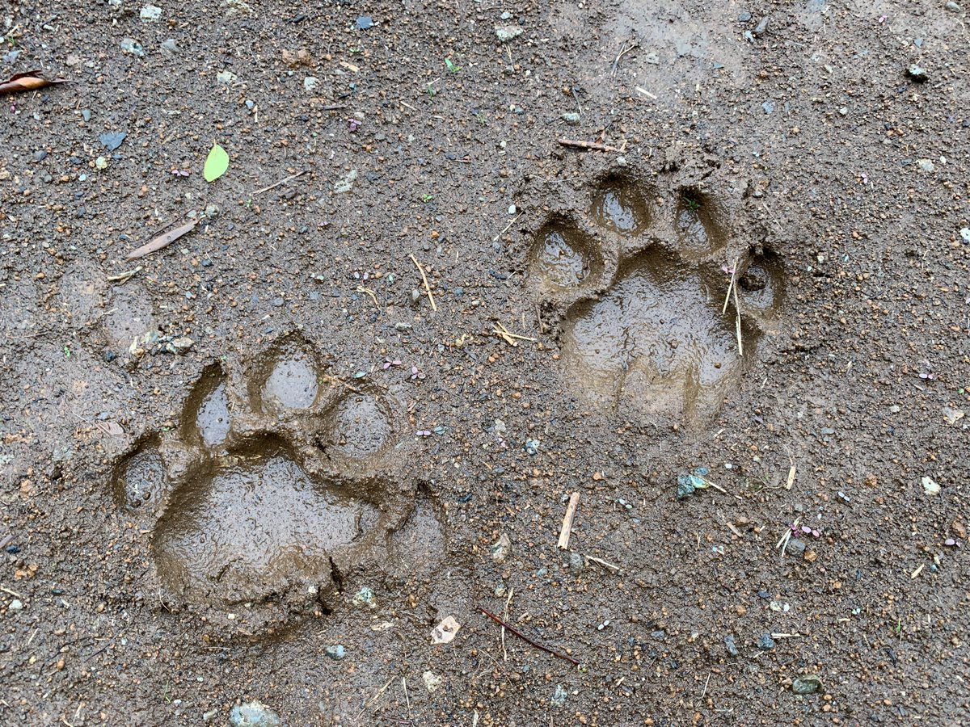
Lion

Slide 31

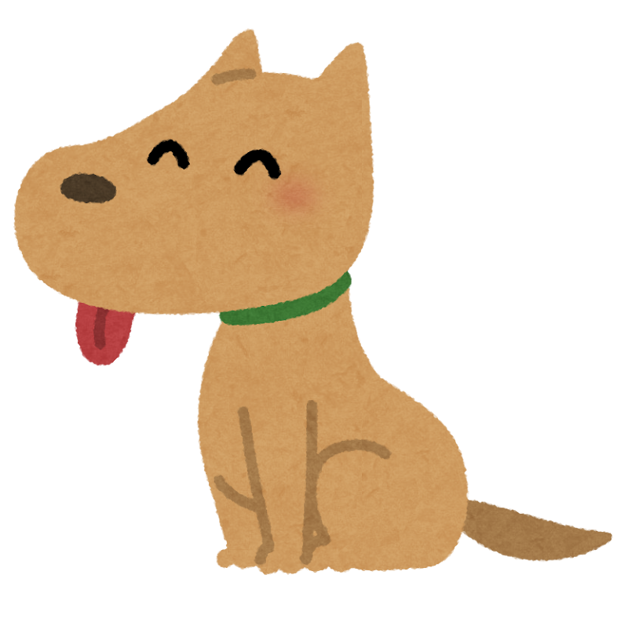

Dog

Slide 32


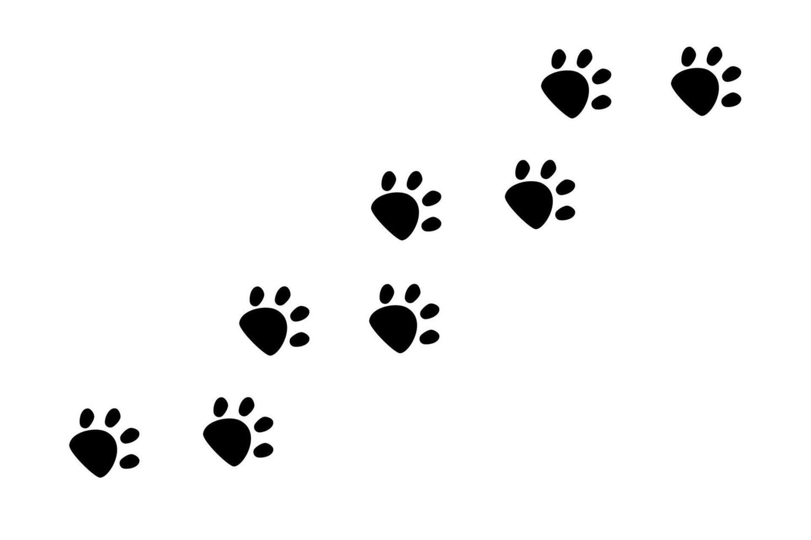
Hamster

Slide 33

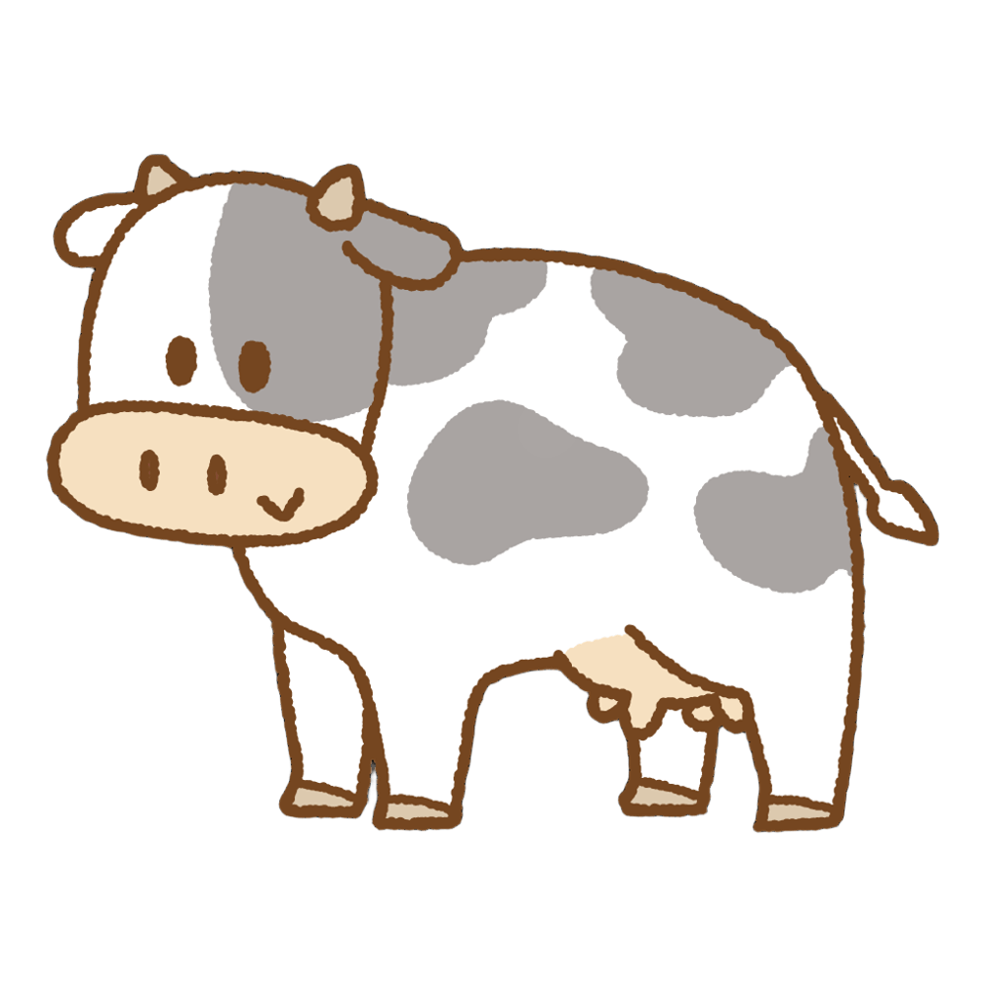
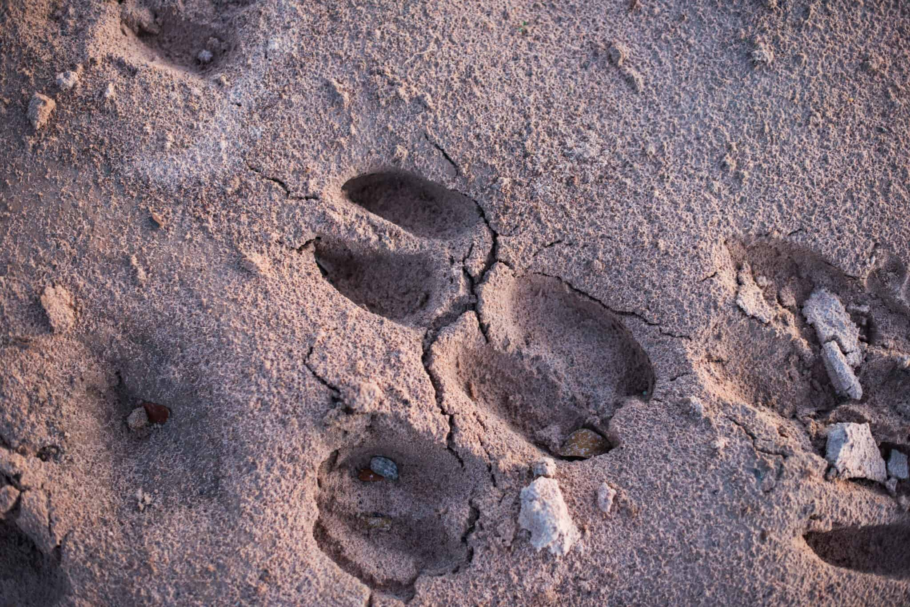
Cow

Slide 34

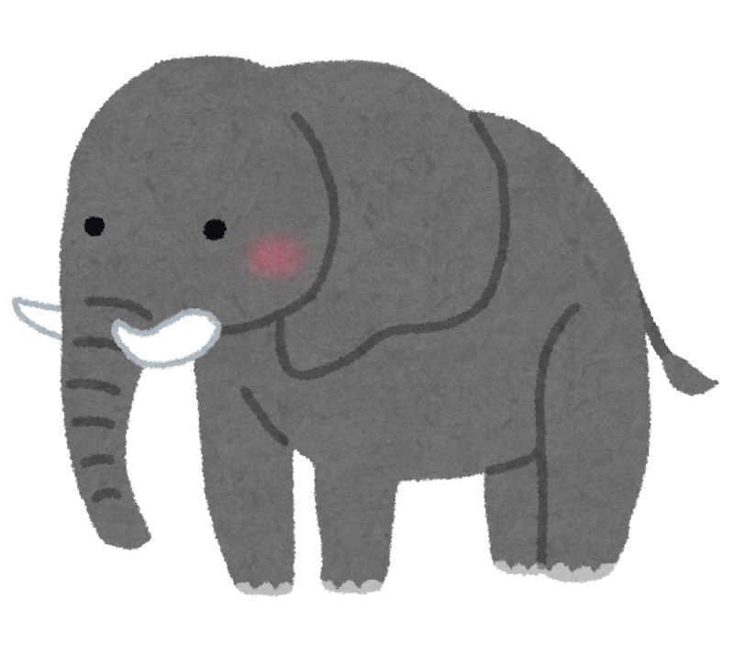
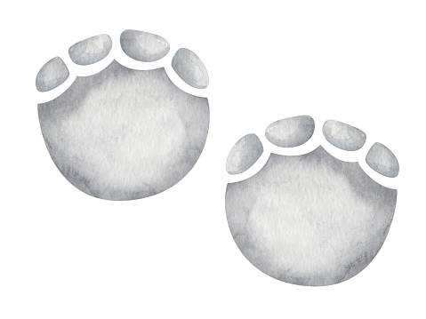
Elephant

Slide 35
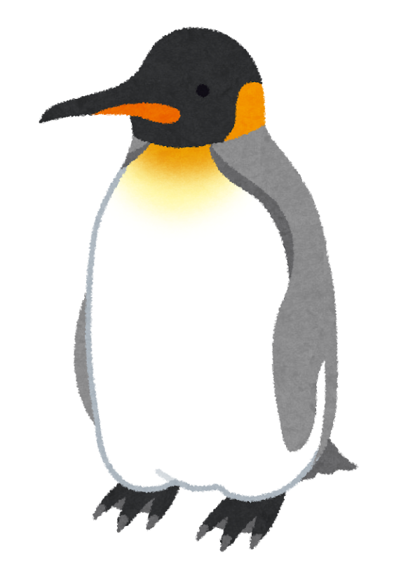
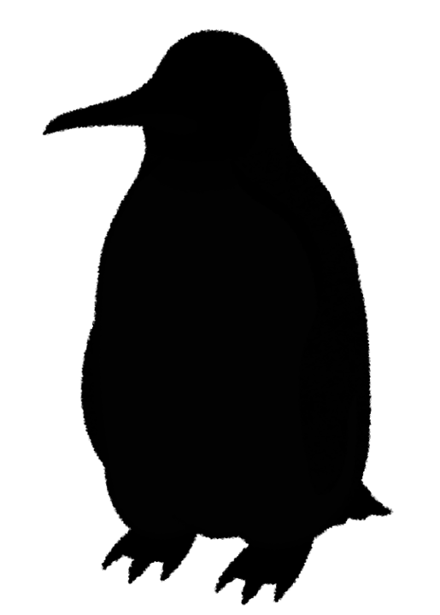





Penguin

Slide 36

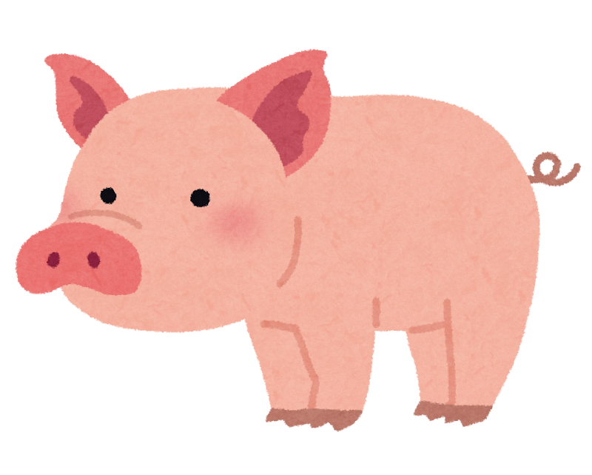


Pig

Slide 37

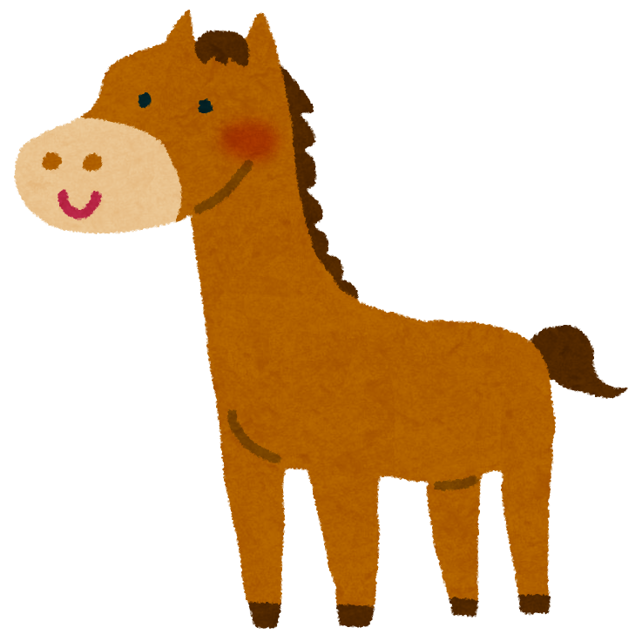

Horse

Slide 38
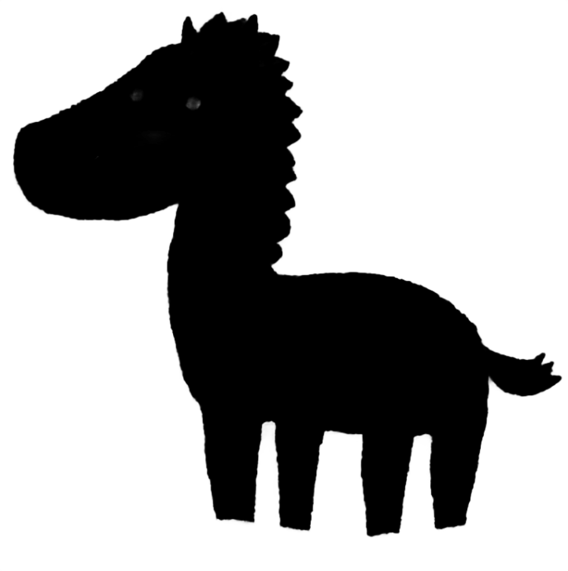
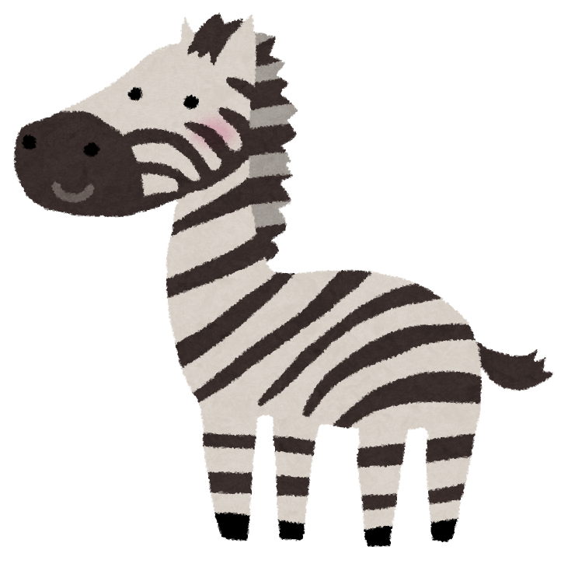












Zebra

Slide 39

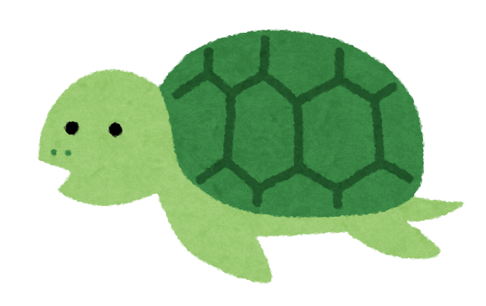
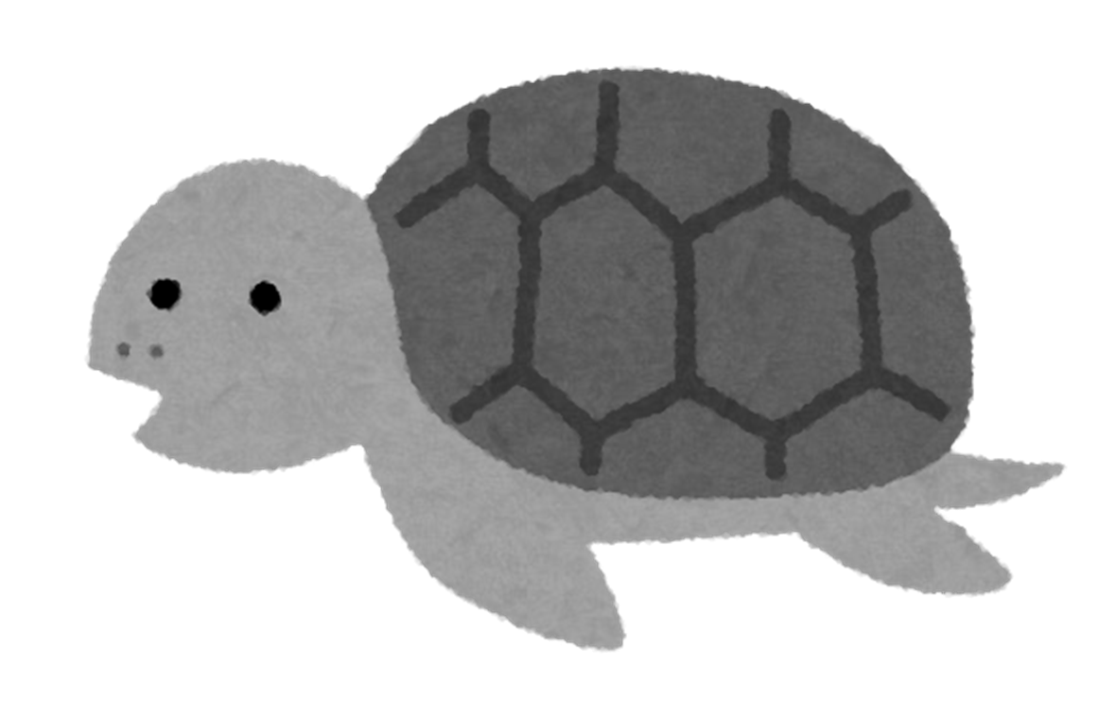
Turtle

Slide 40

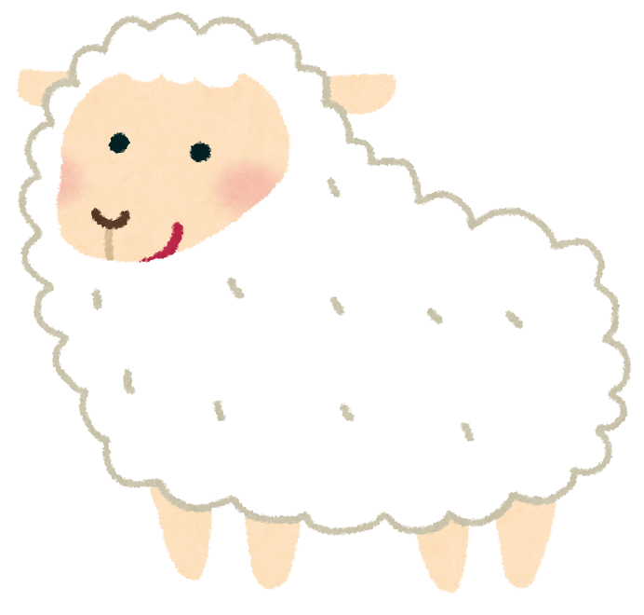
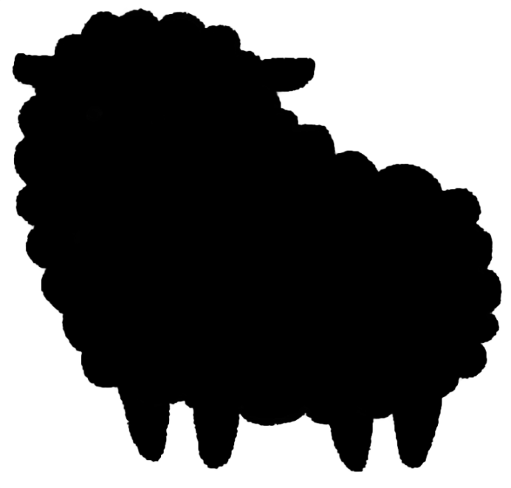
Sheep

Slide 41
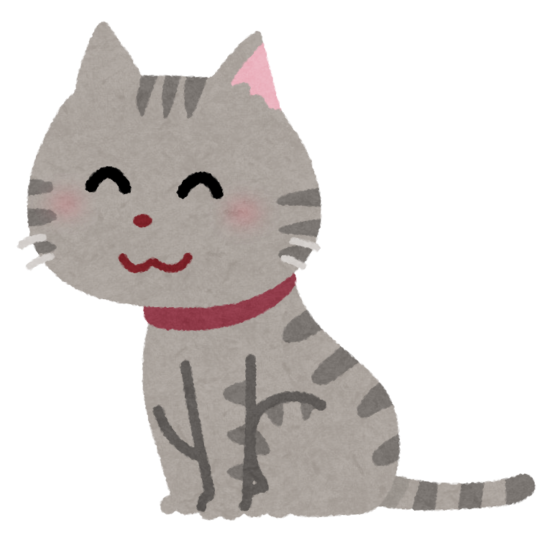


Cat

Slide 42

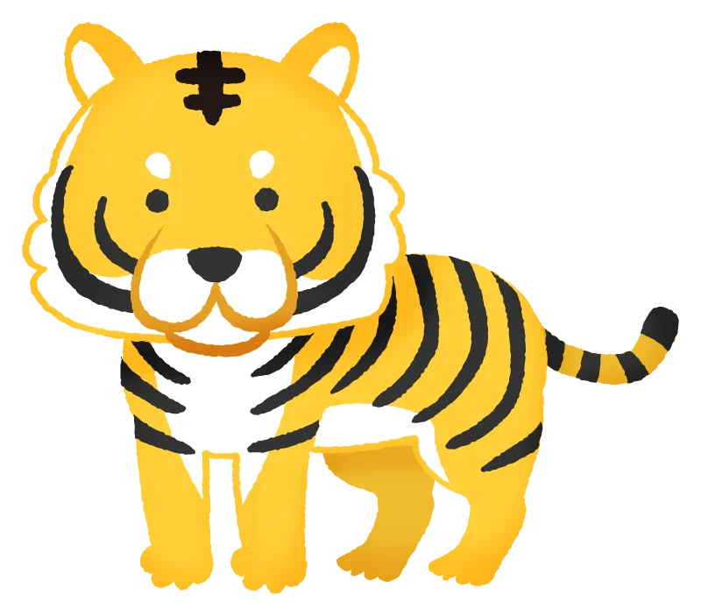
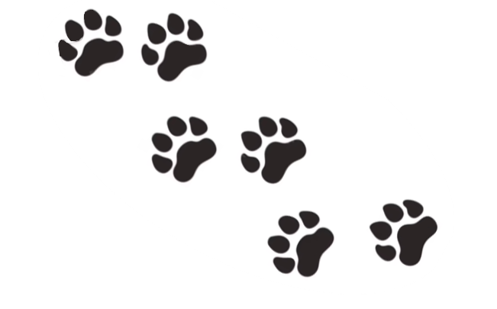
Tiger

Slide 43
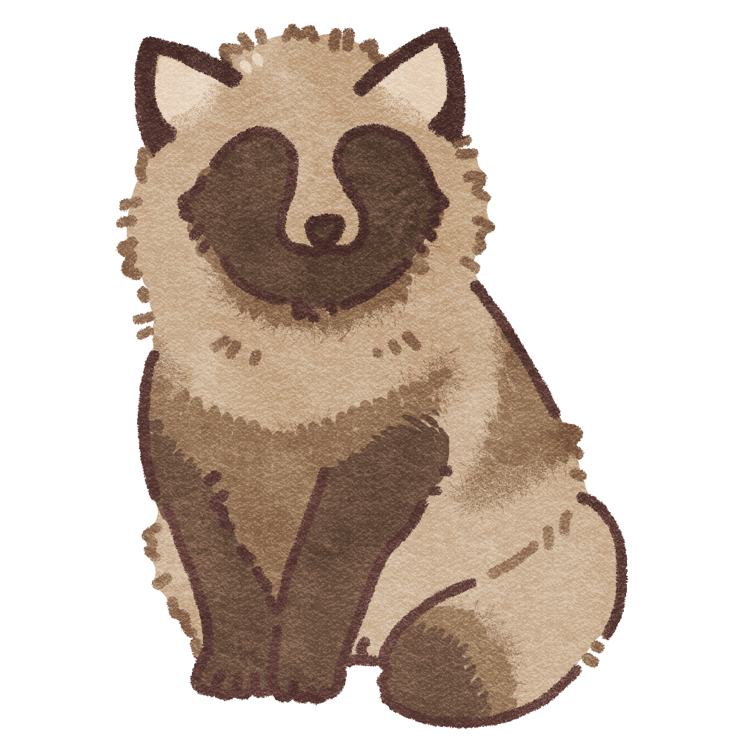
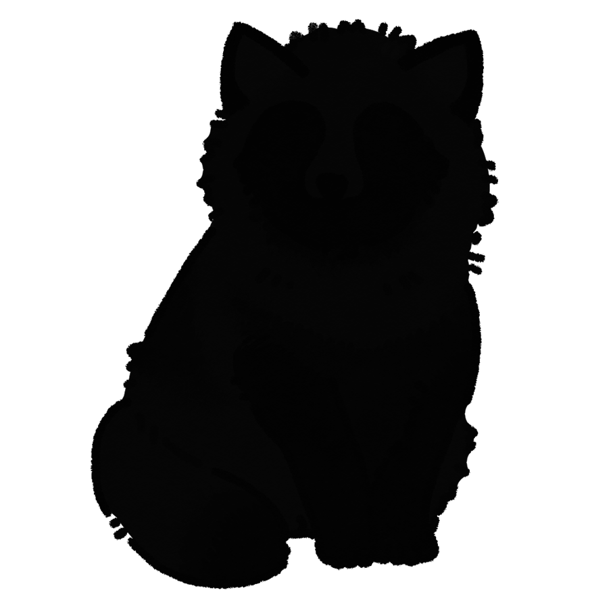

Raccoon dog

Slide 44



Lizard

Slide 45








Cheetah

Slide 46



Rabbit

Slide 47



Leopard

Slide 48



Wolf

Slide 49



Iguana

Slide 50



Otter

Slide 51



Sparrow

Slide 52



Crocodile

Slide 53



Fox

Slide 54



Snake

